Slide 1
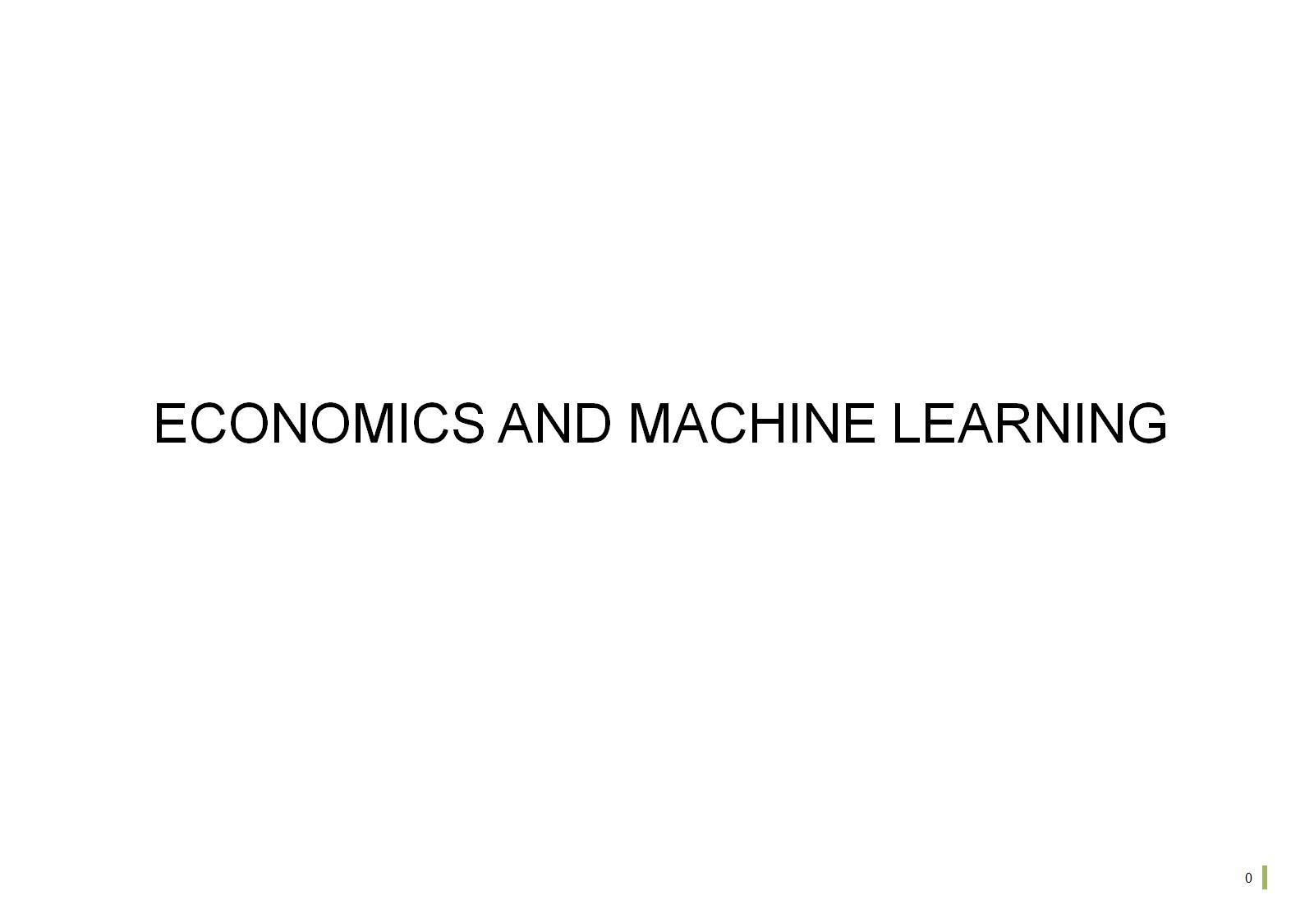

Slide 2
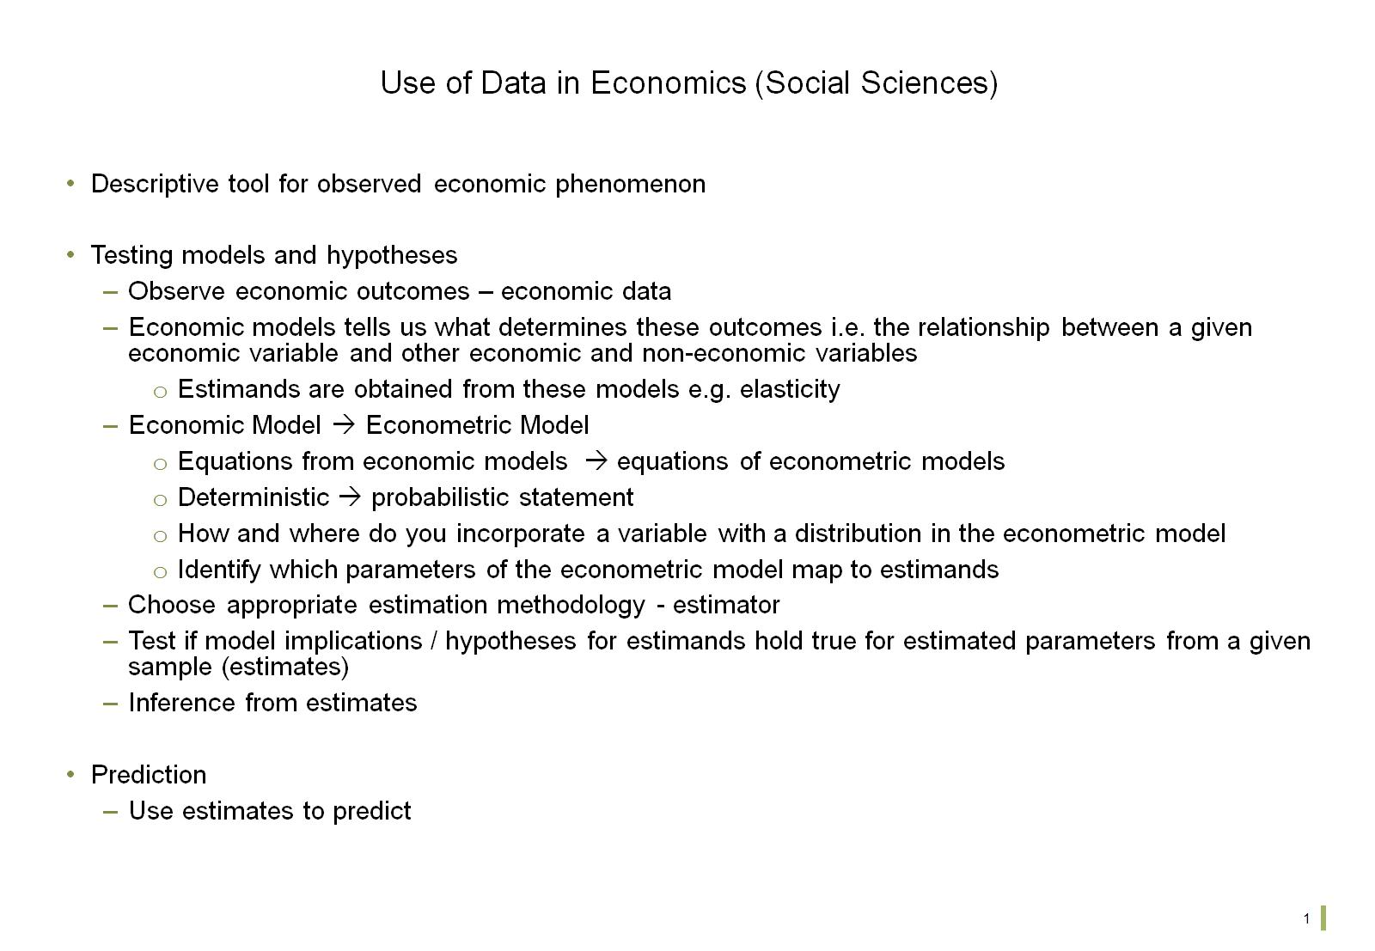
Use of Data in Economics (Social Sciences)

Slide 3
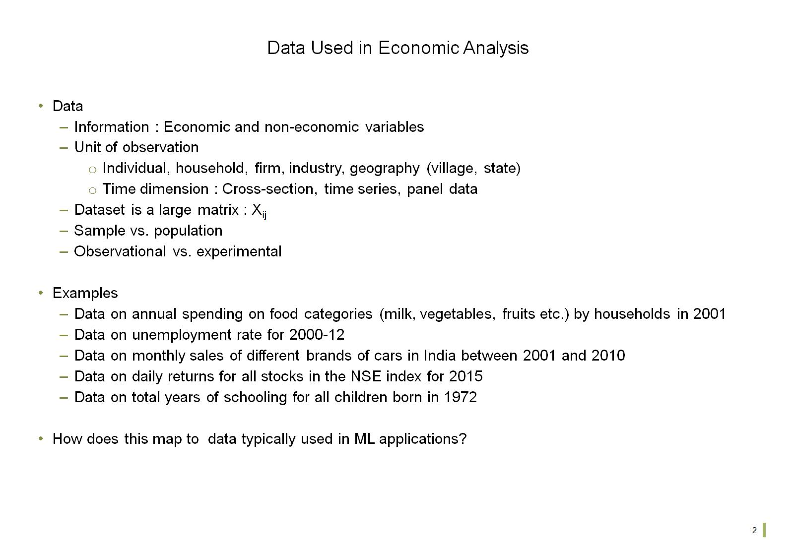
Data Used in Economic Analysis

Slide 4
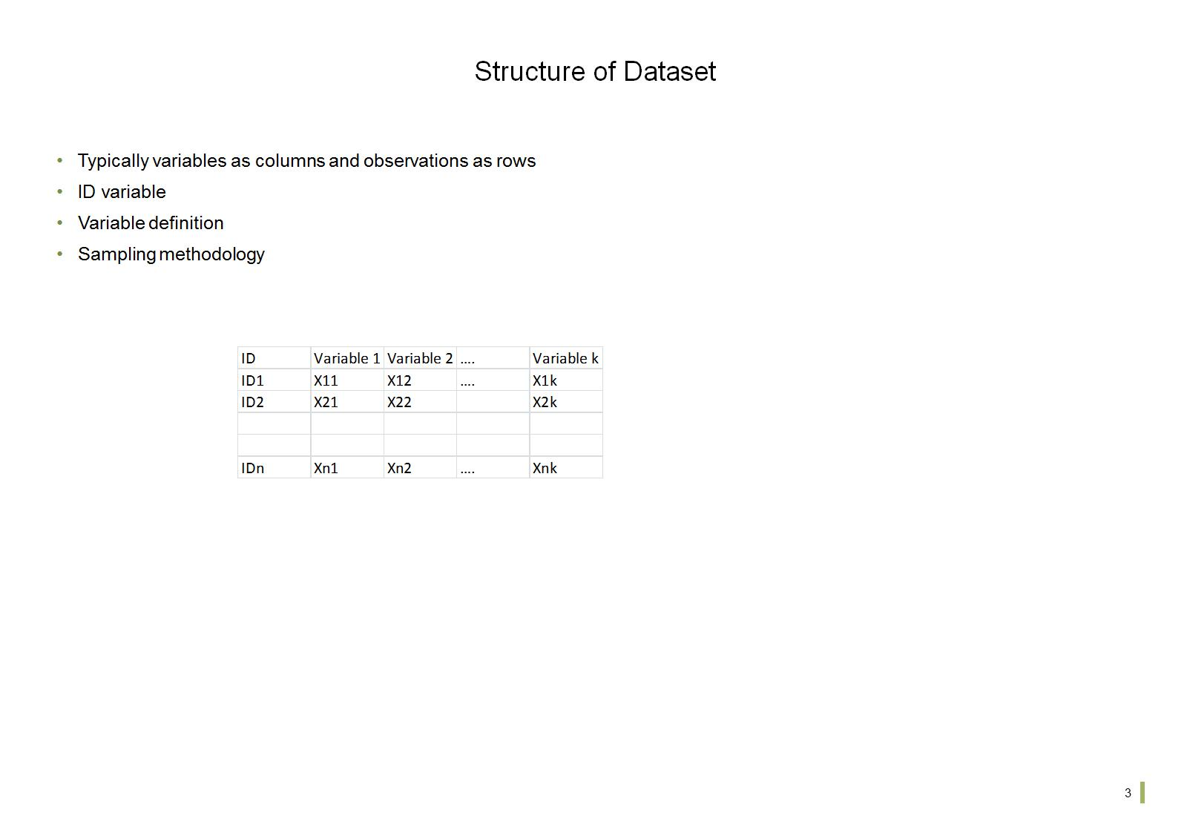
Structure of Dataset

Slide 5
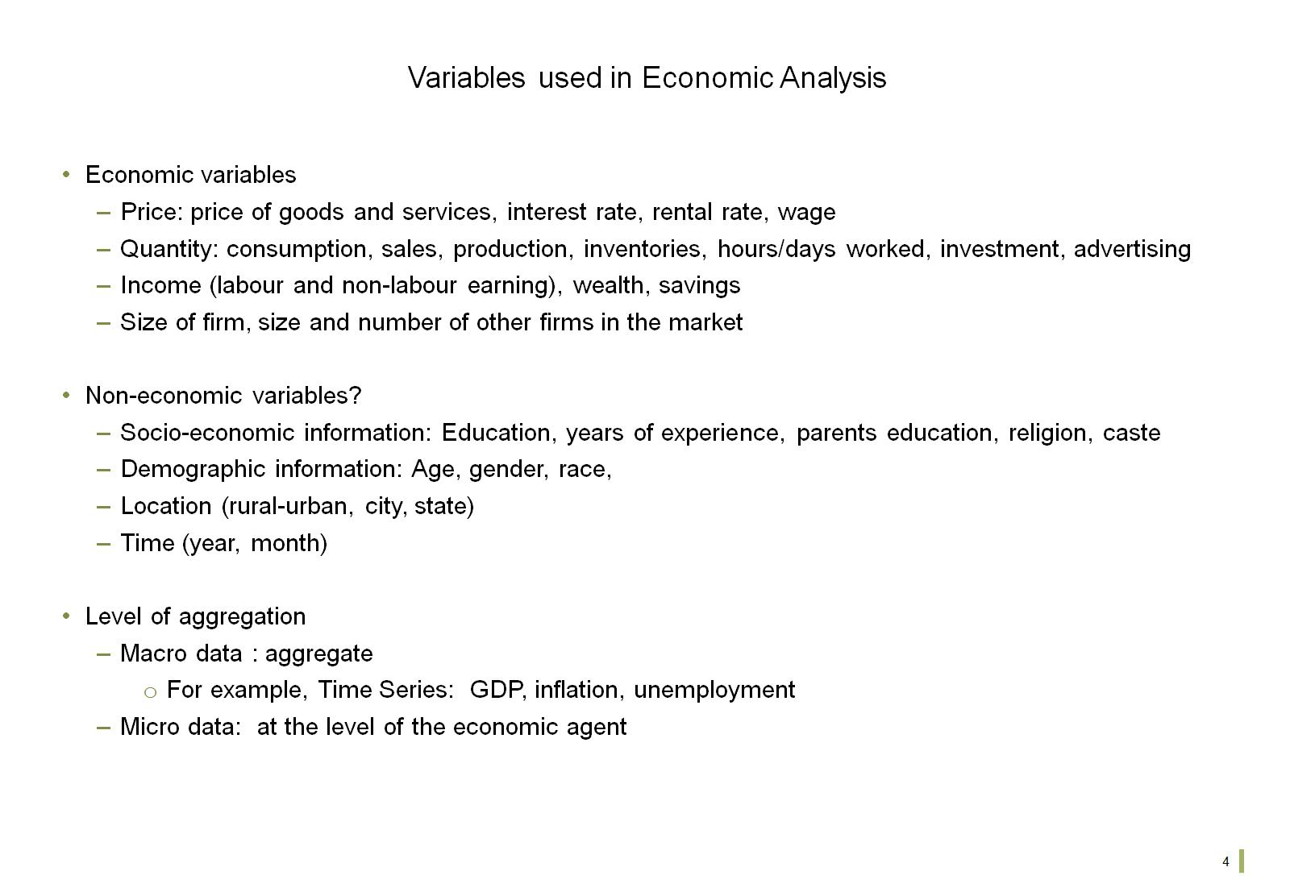
Variables used in Economic Analysis

Slide 6
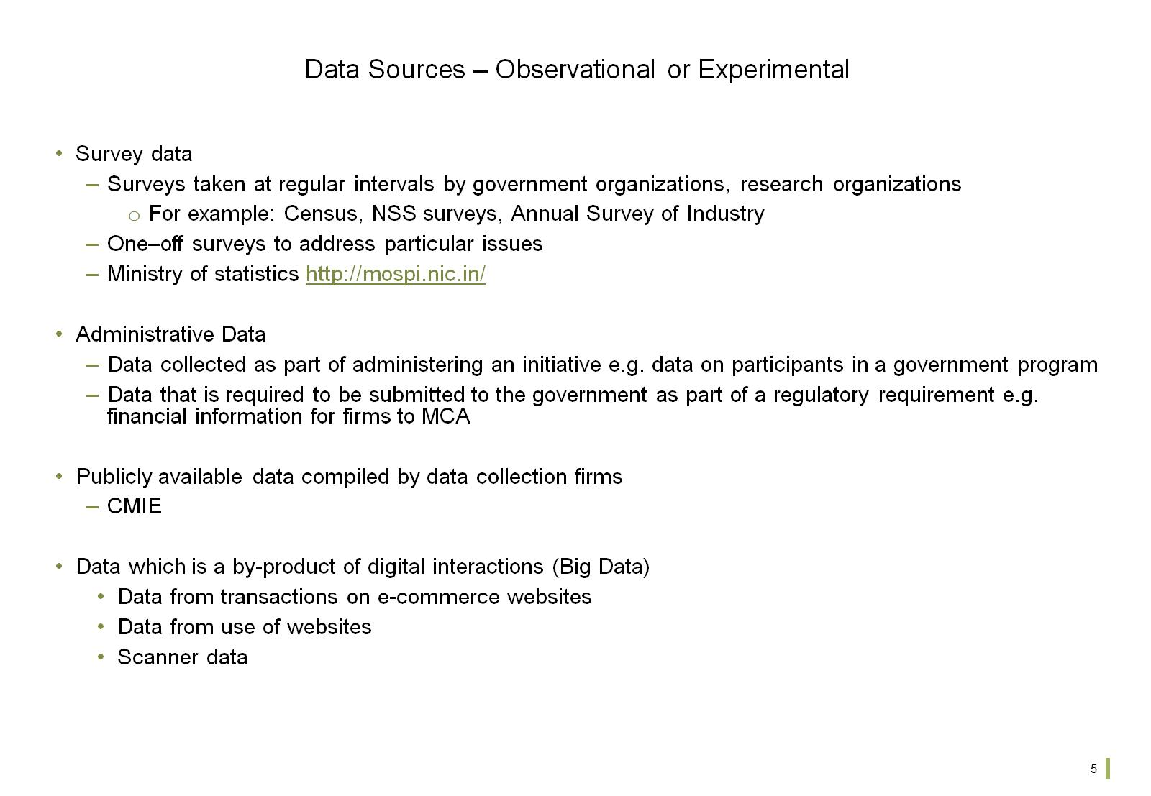
Data Sources – Observational or Experimental

Slide 7
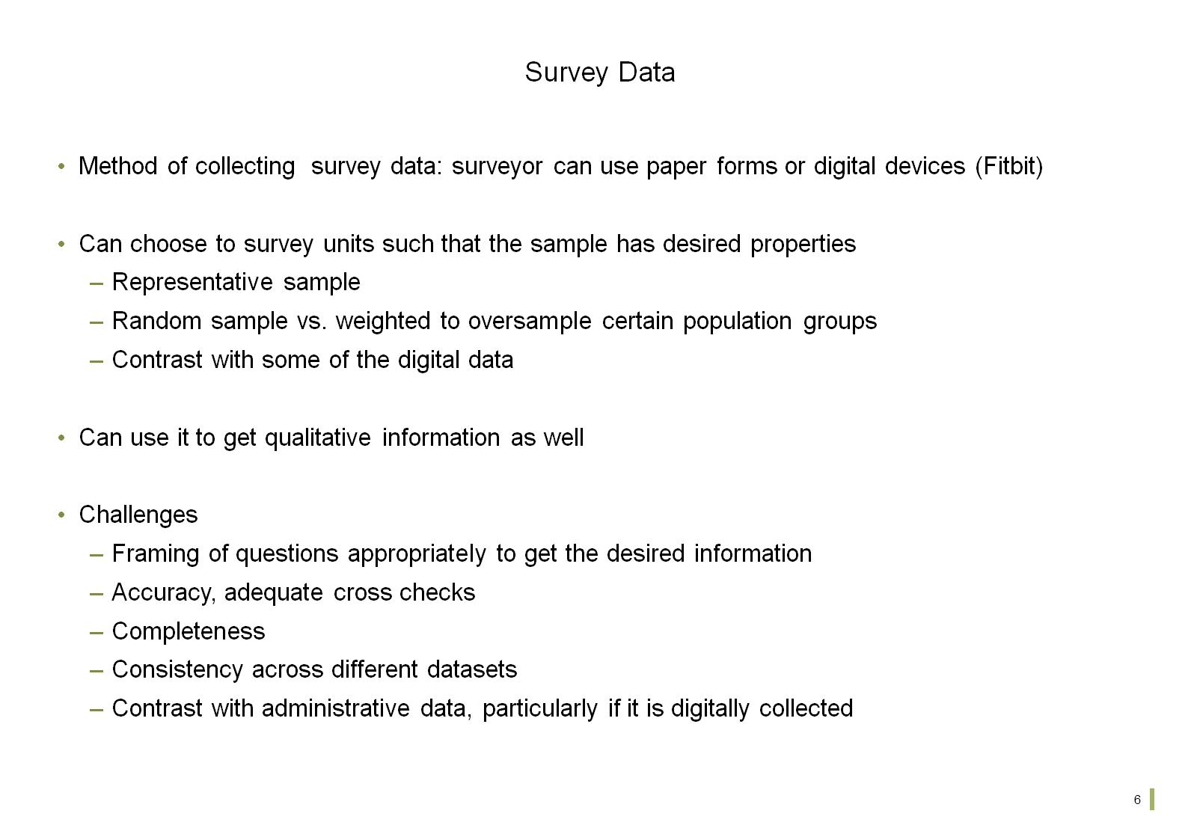
Survey Data

Slide 8
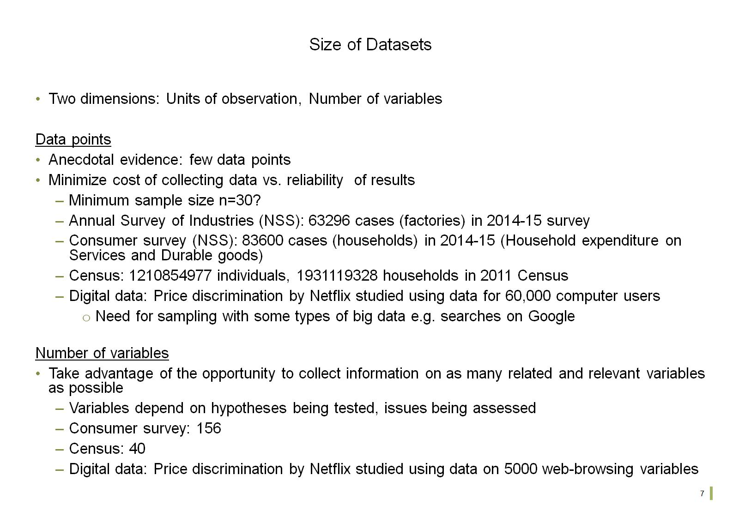
Size of Datasets

Slide 9
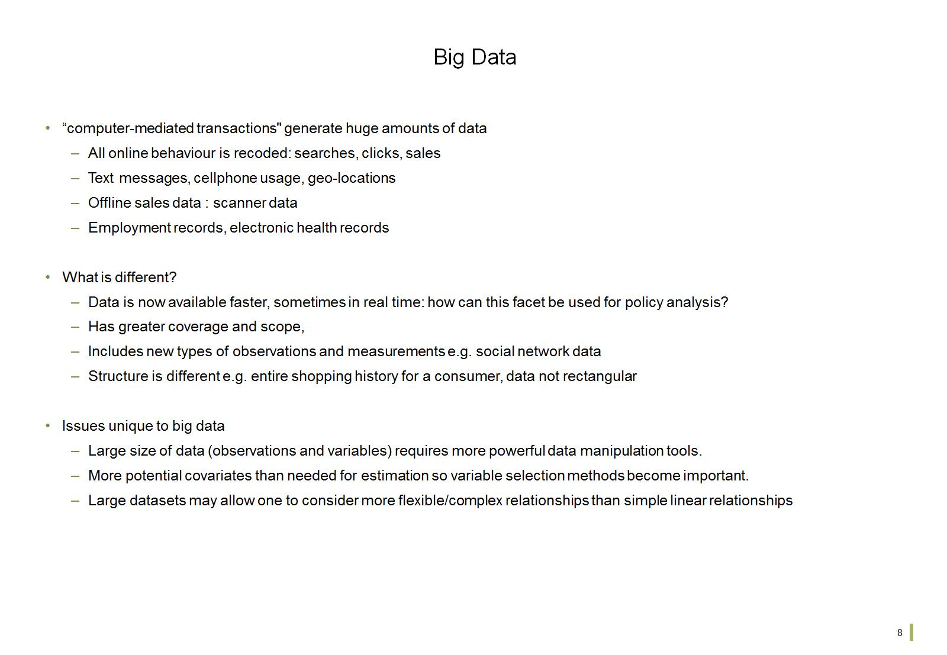
Big Data

Slide 10
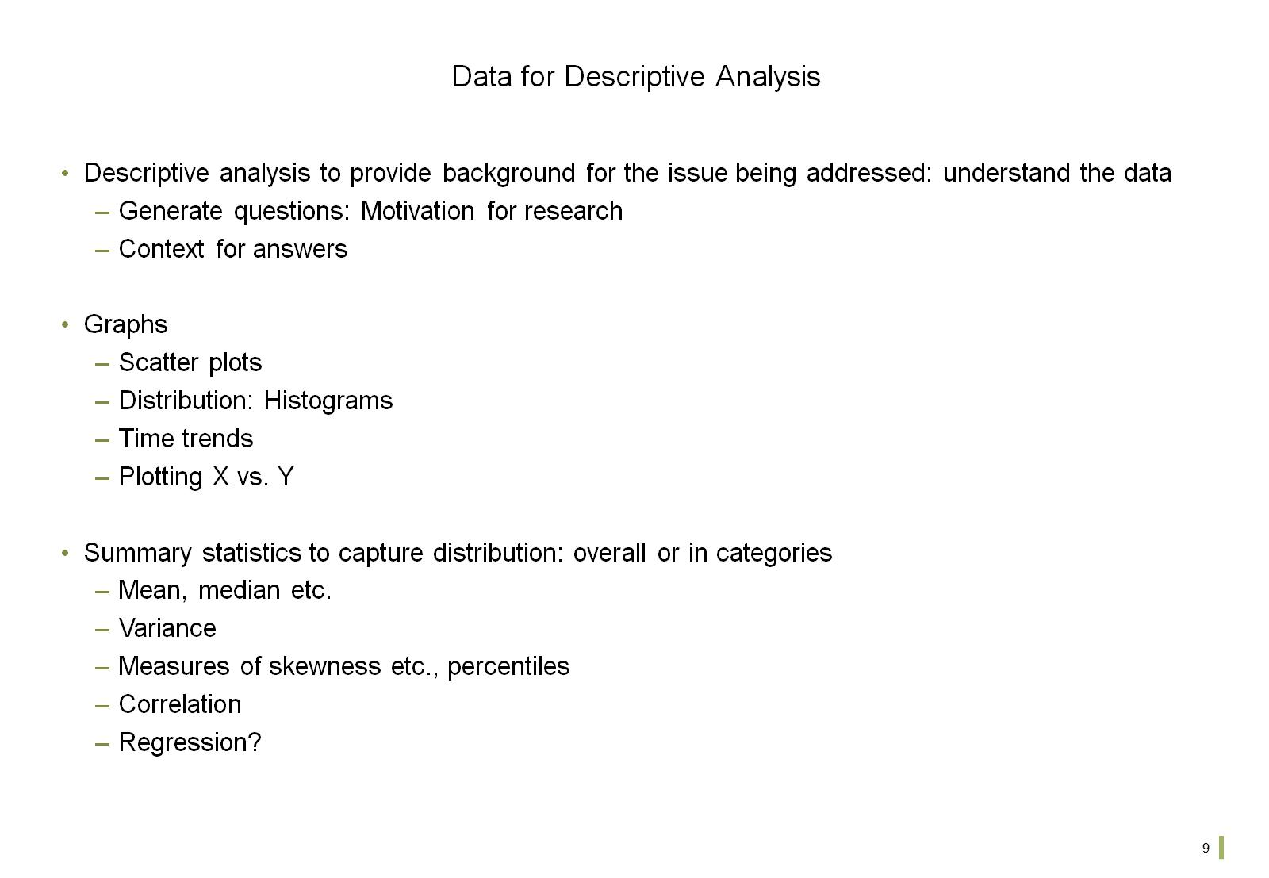
Data for Descriptive Analysis

Slide 11
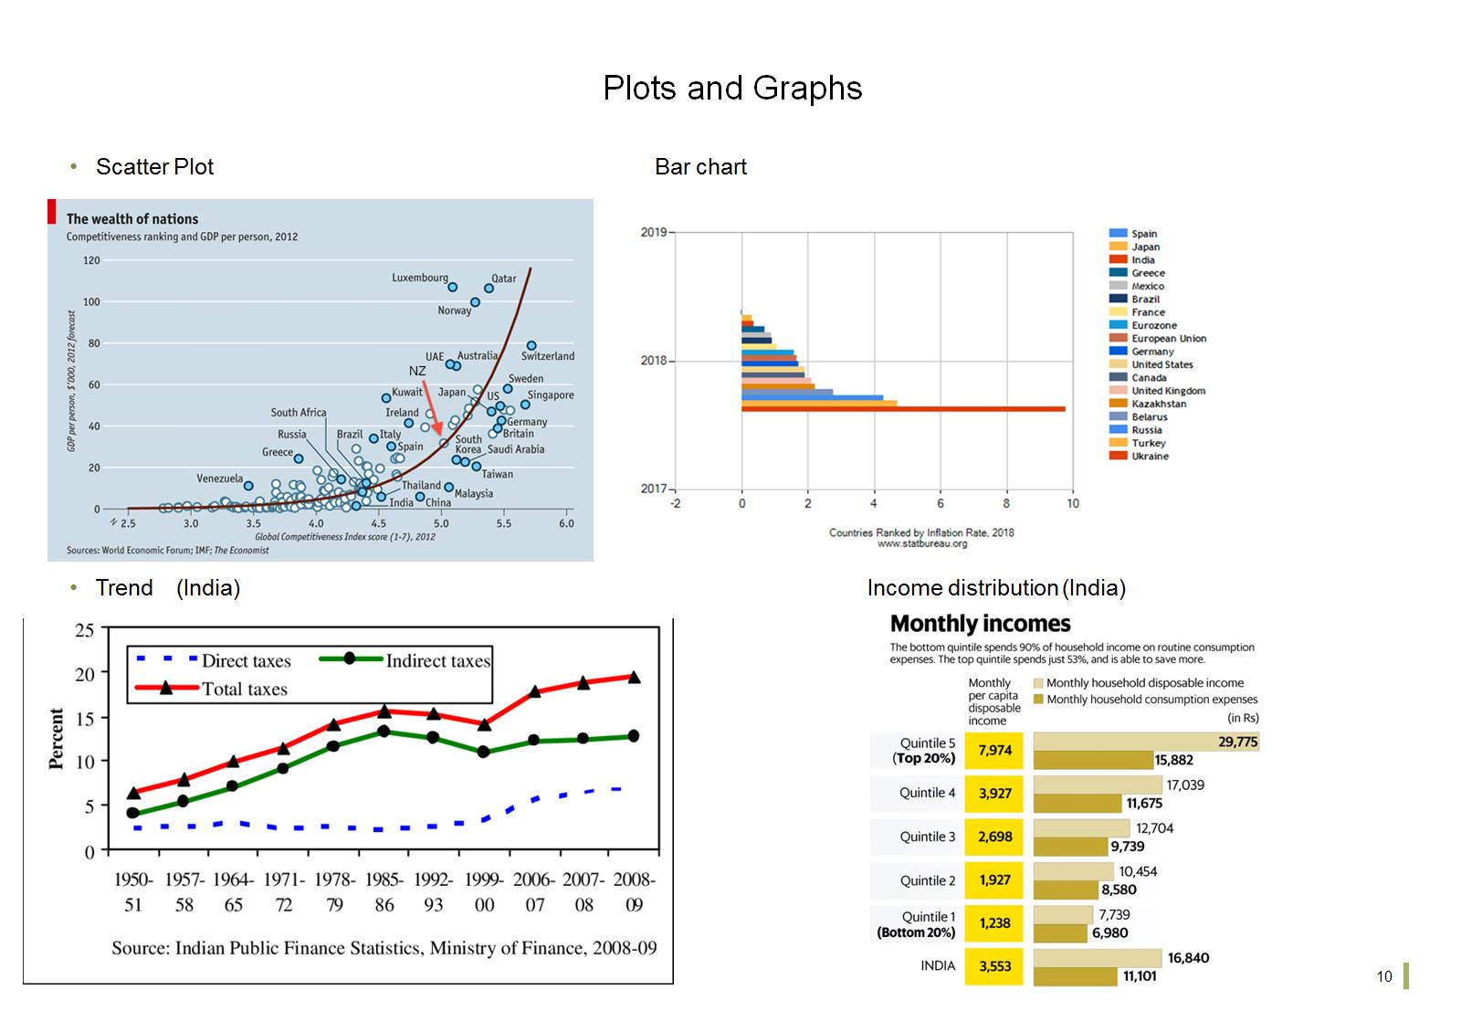
Plots and Graphs

Slide 12
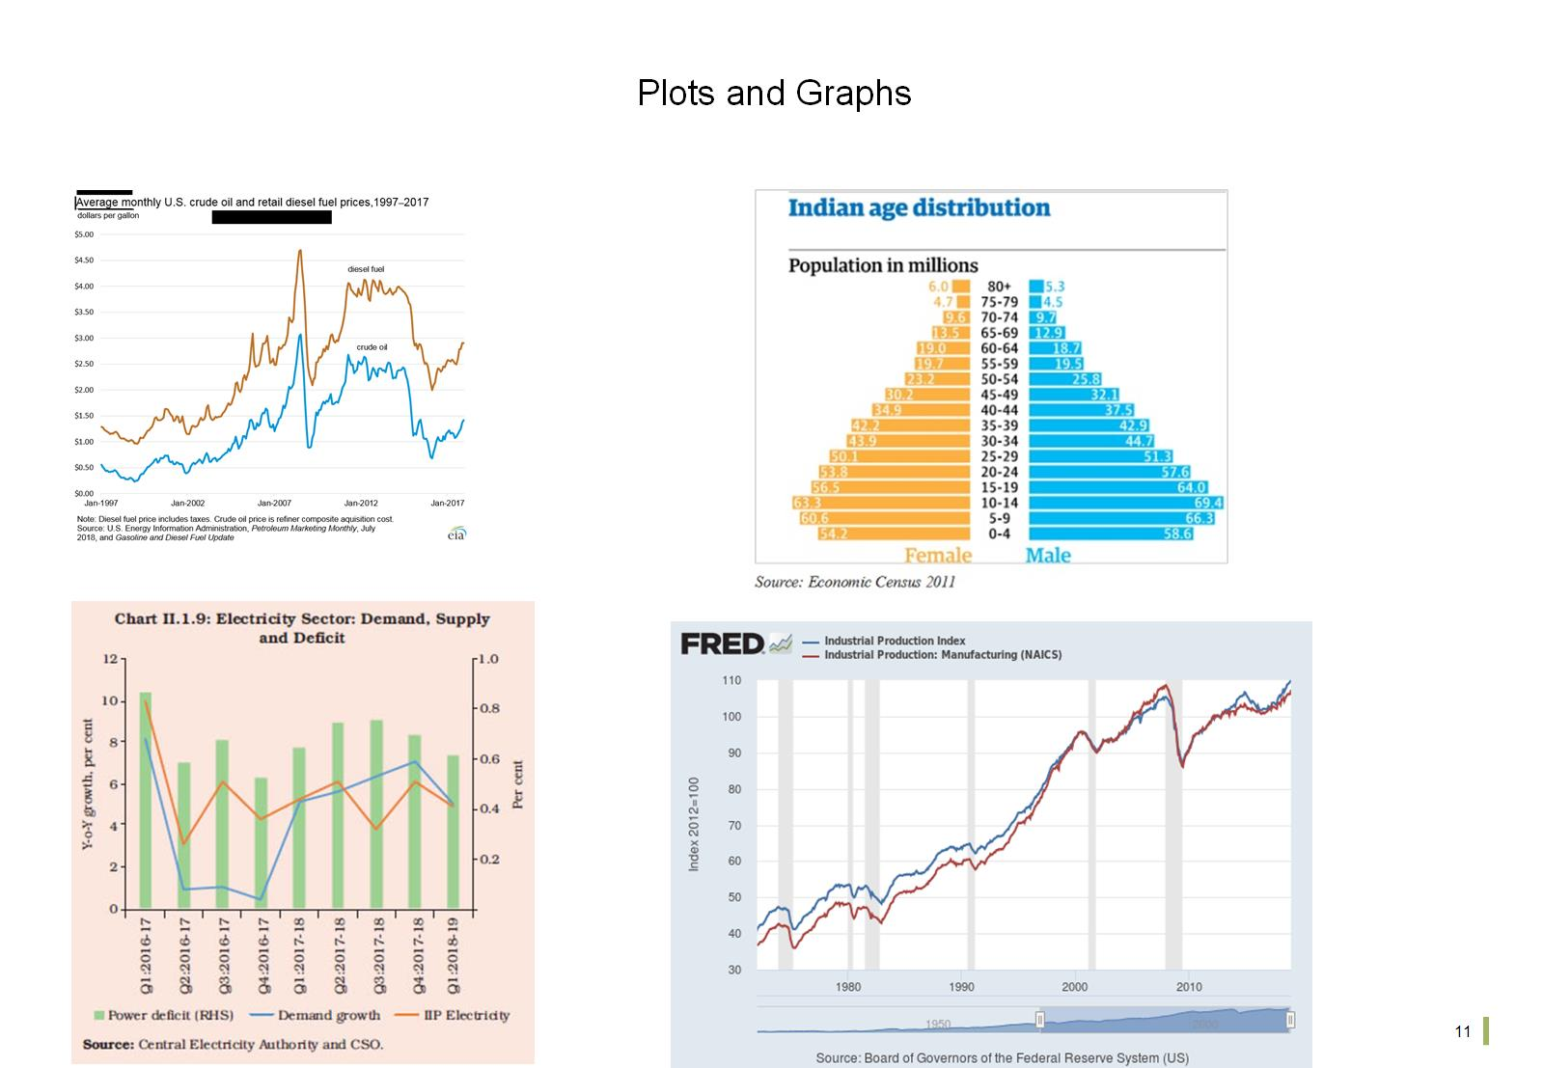
Plots and Graphs

Slide 13
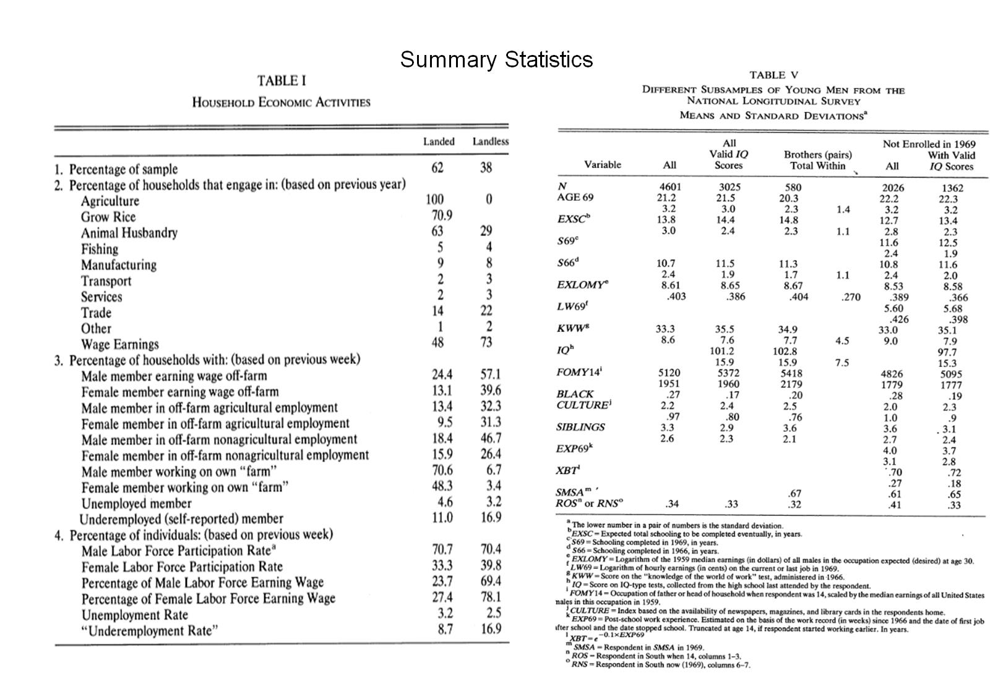
Summary Statistics

Slide 14
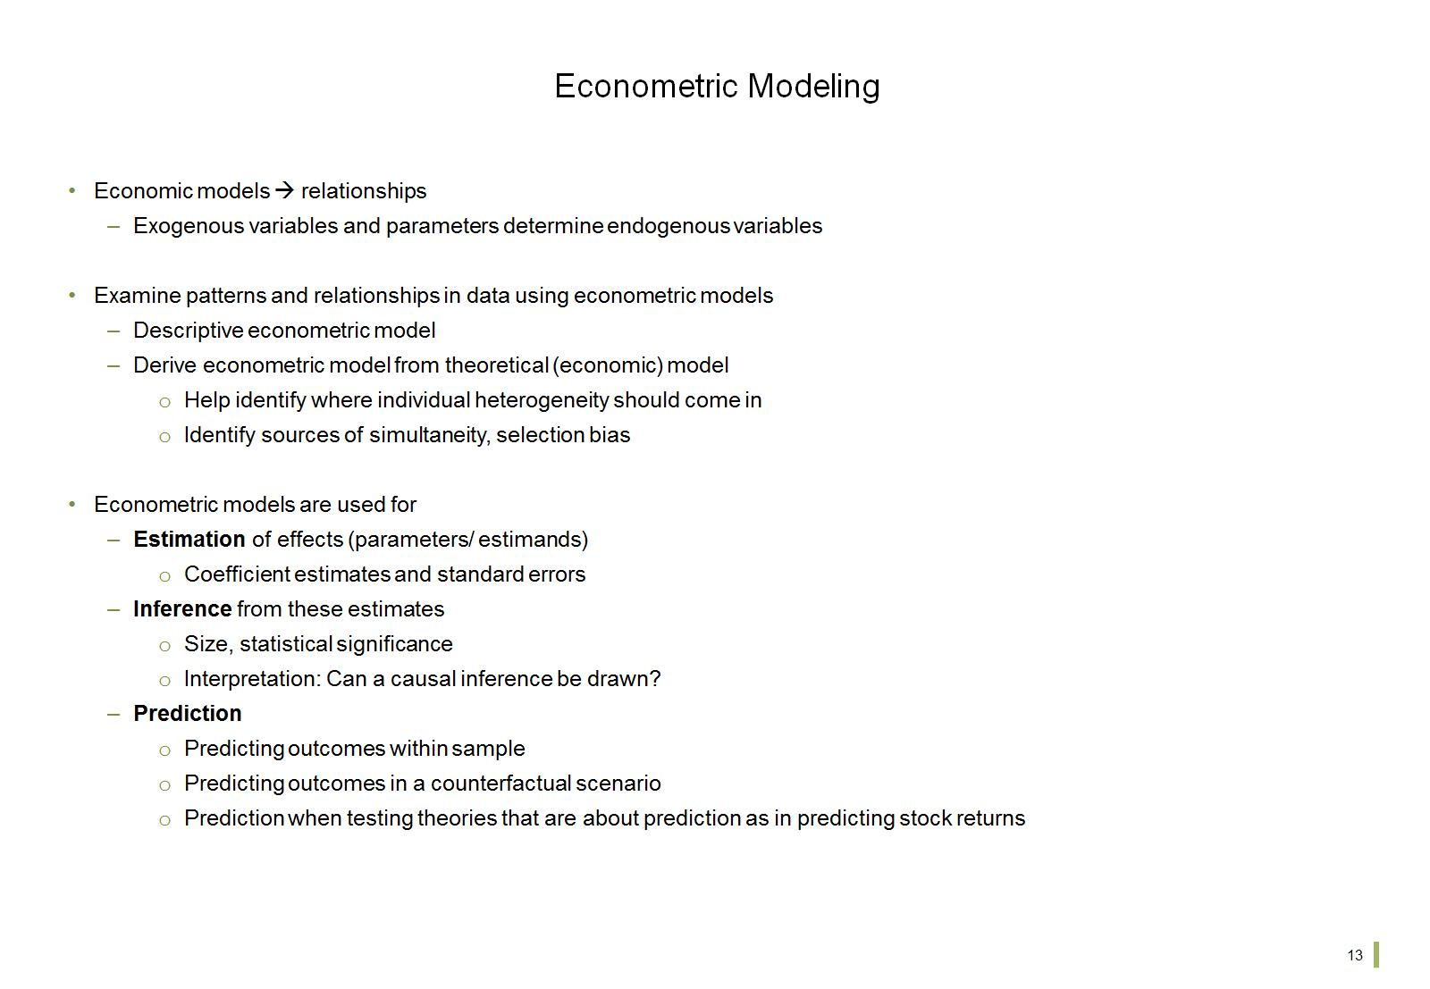
Econometric Modeling

Slide 15
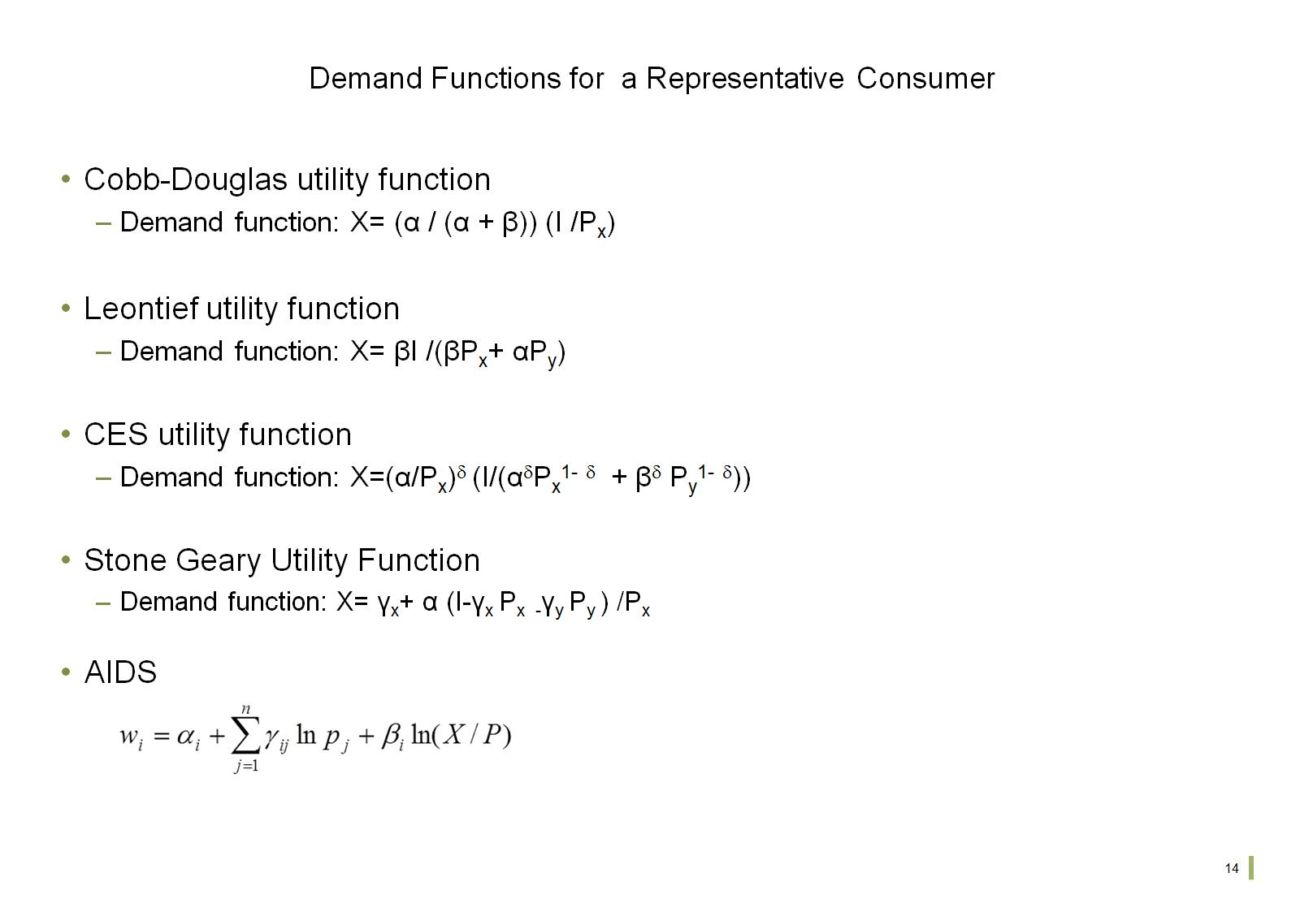
Demand Functions for a Representative Consumer

Slide 16
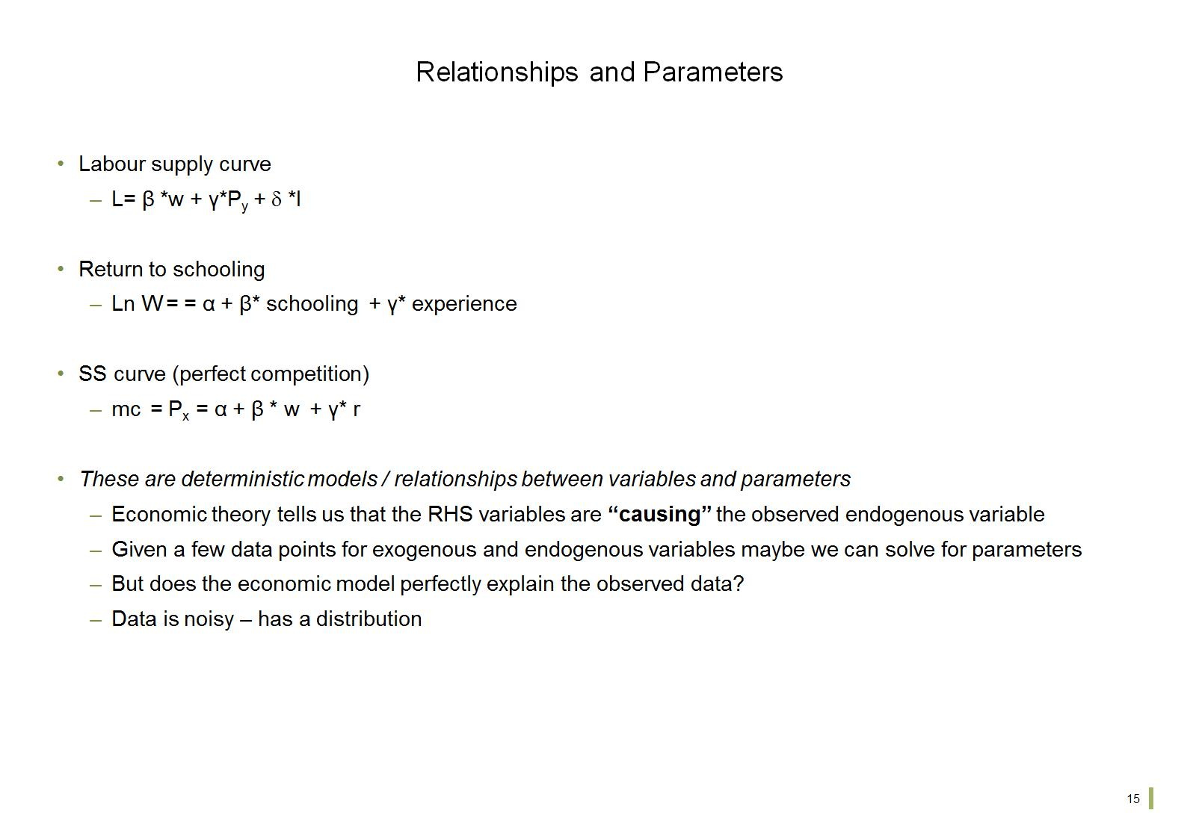
Relationships and Parameters

Slide 17
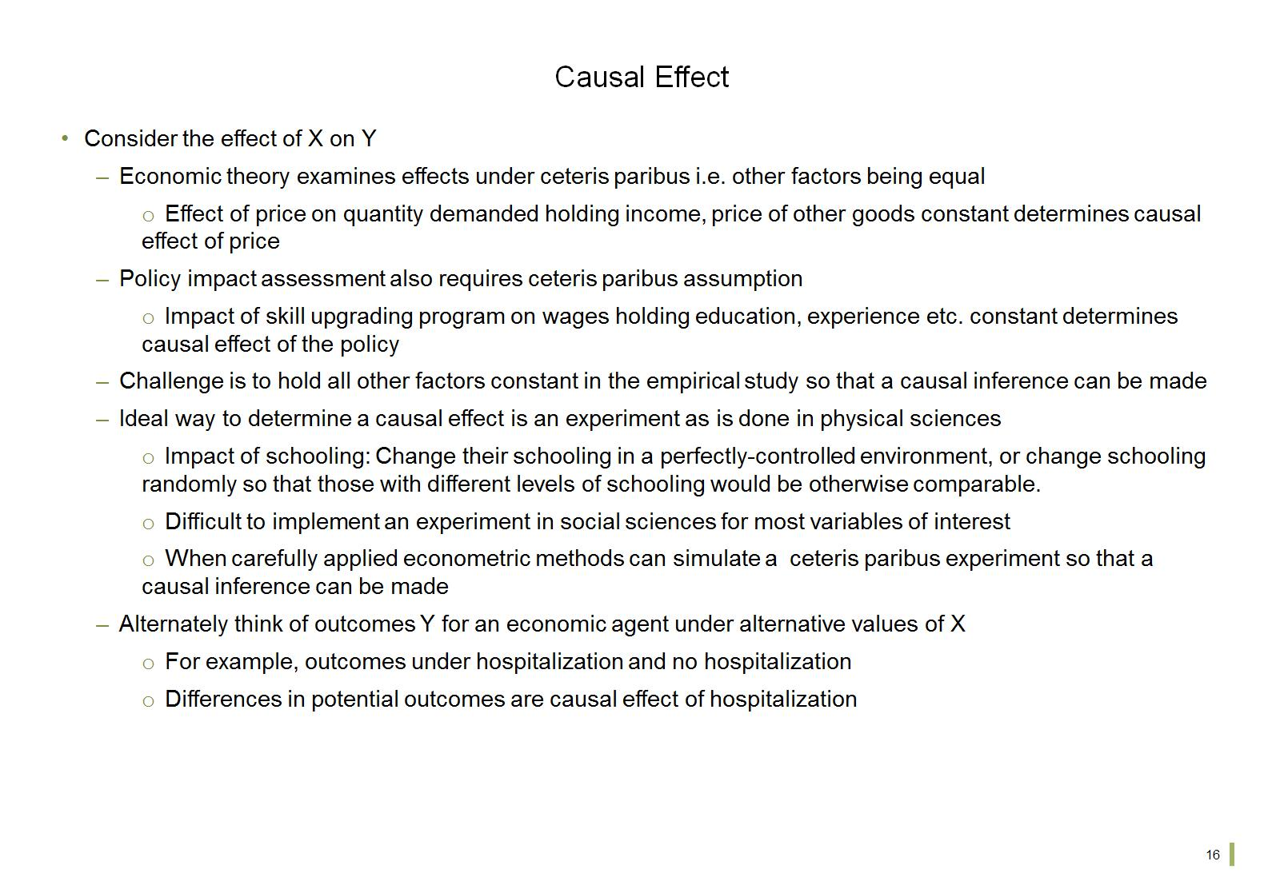
Causal Effect

Slide 18
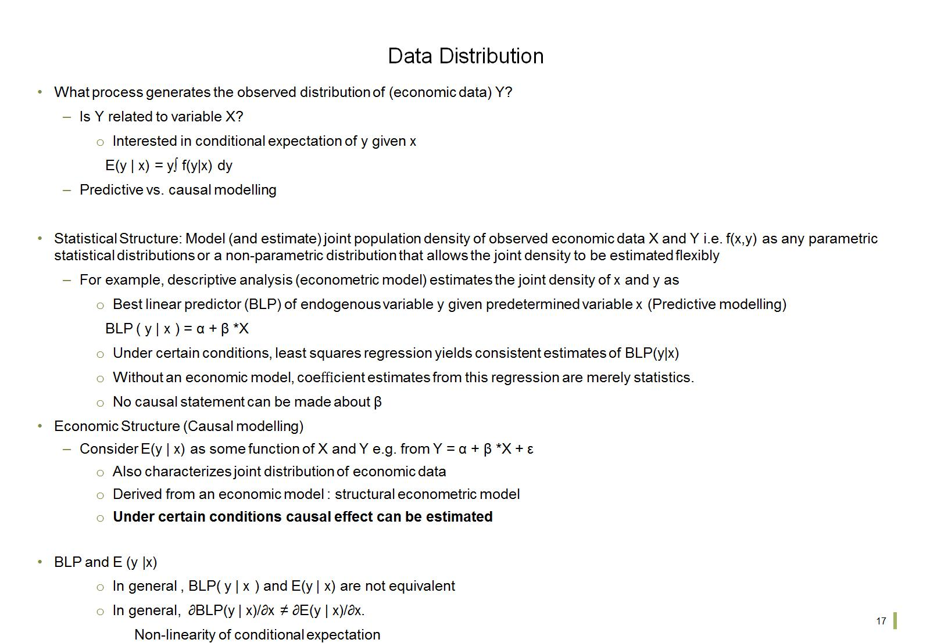
Data Distribution

Slide 19
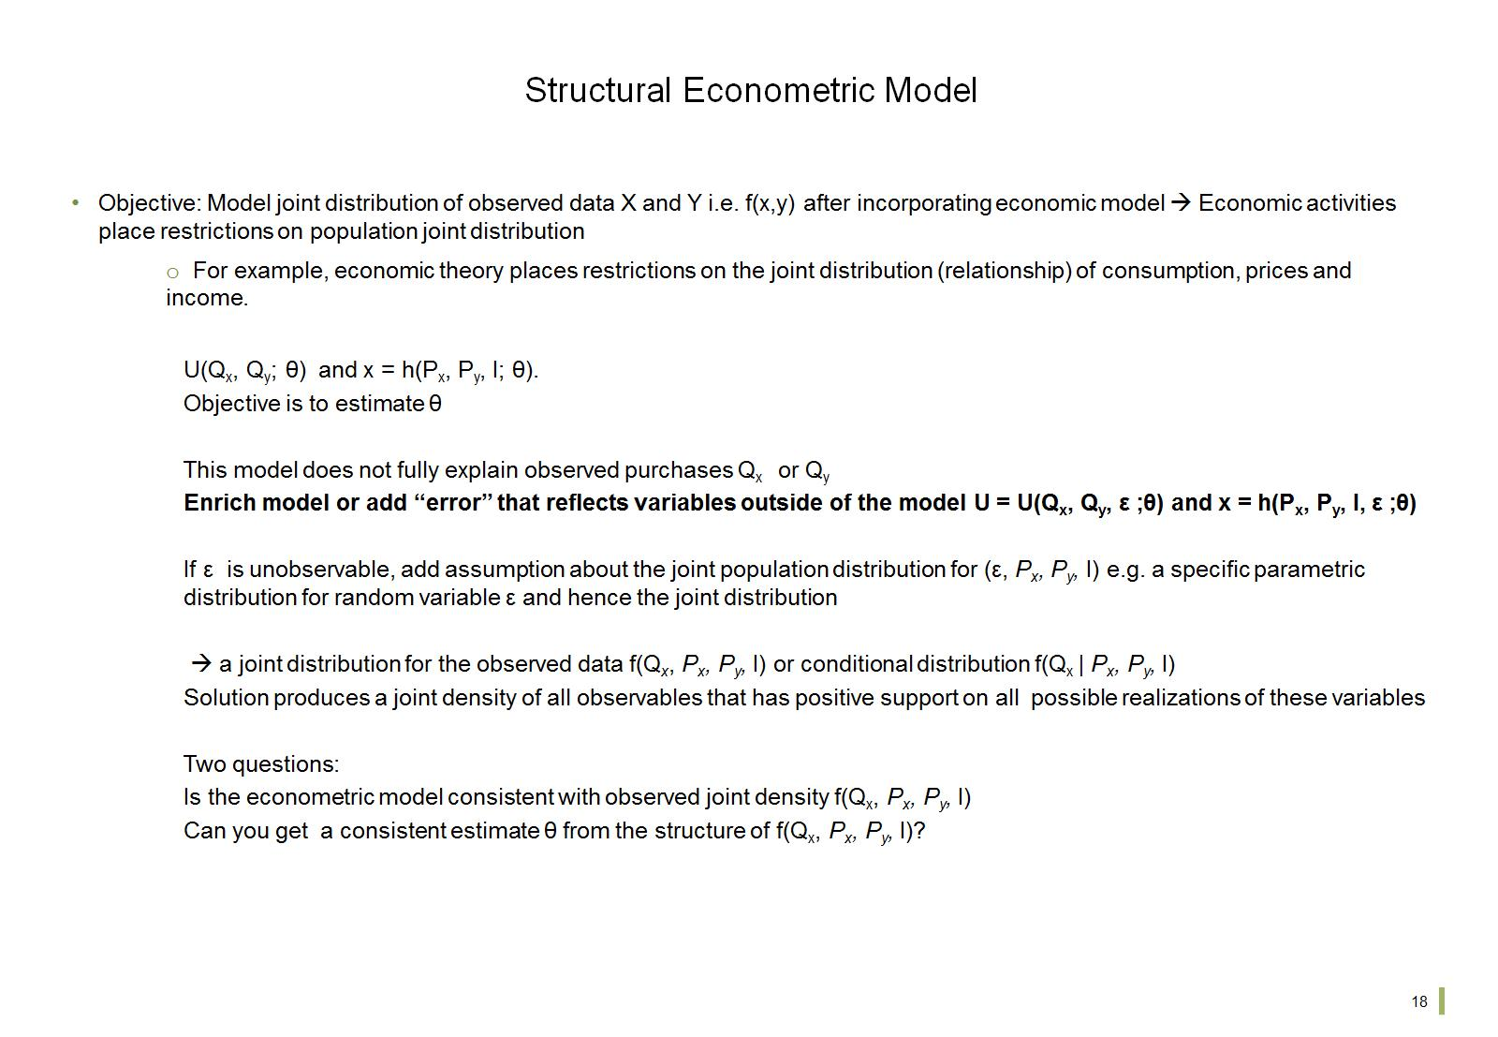
Structural Econometric Model

Slide 20
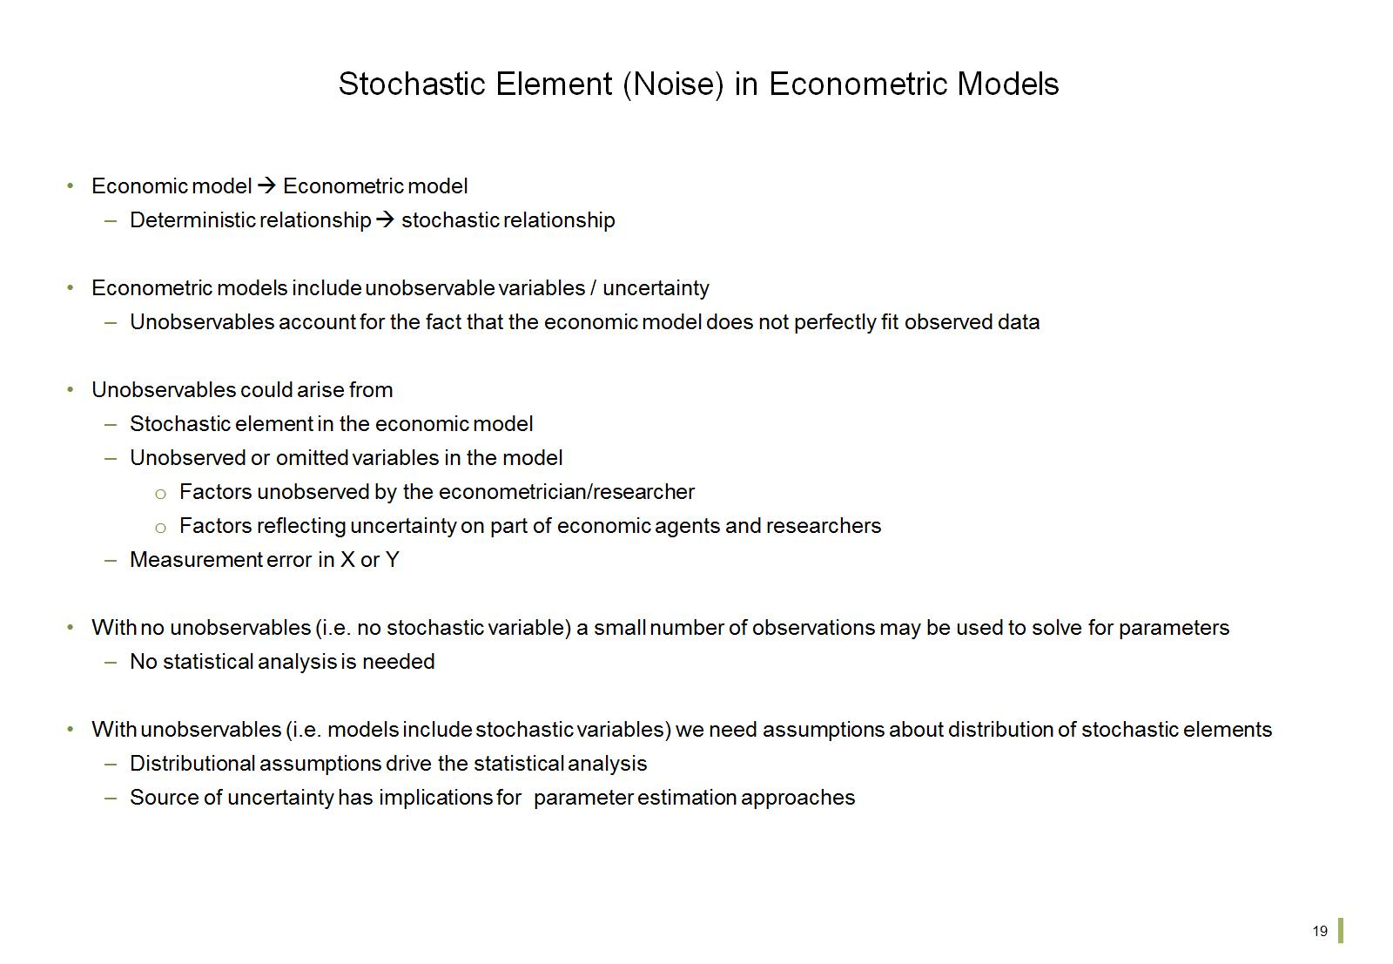
Stochastic Element (Noise) in Econometric Models

Slide 21
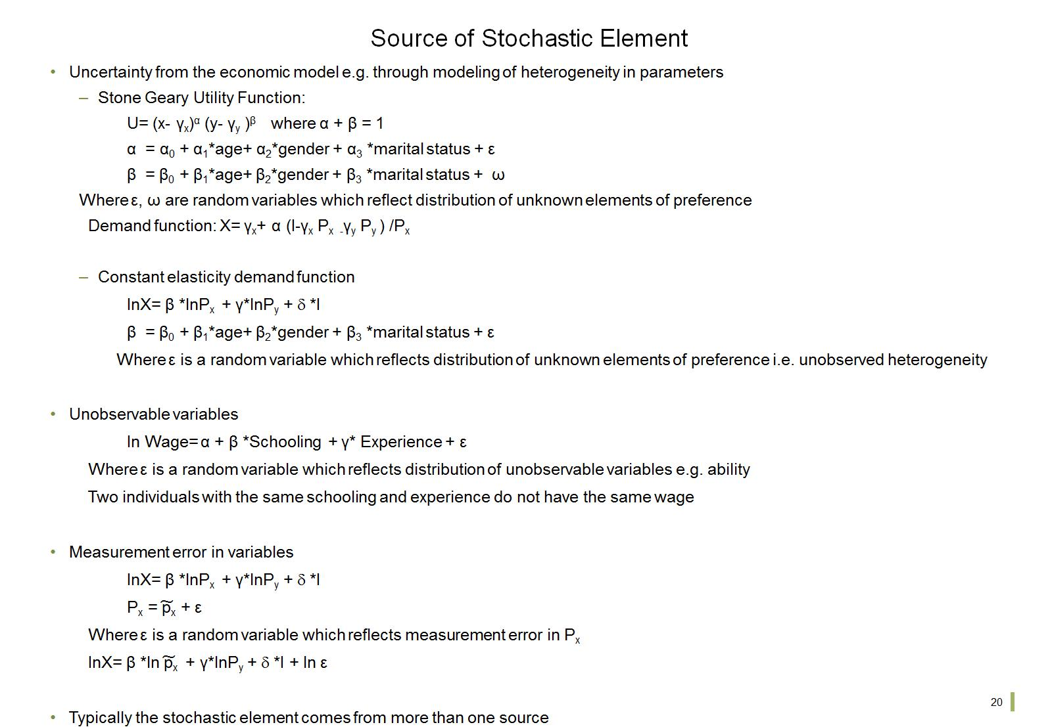
Source of Stochastic Element

Slide 22
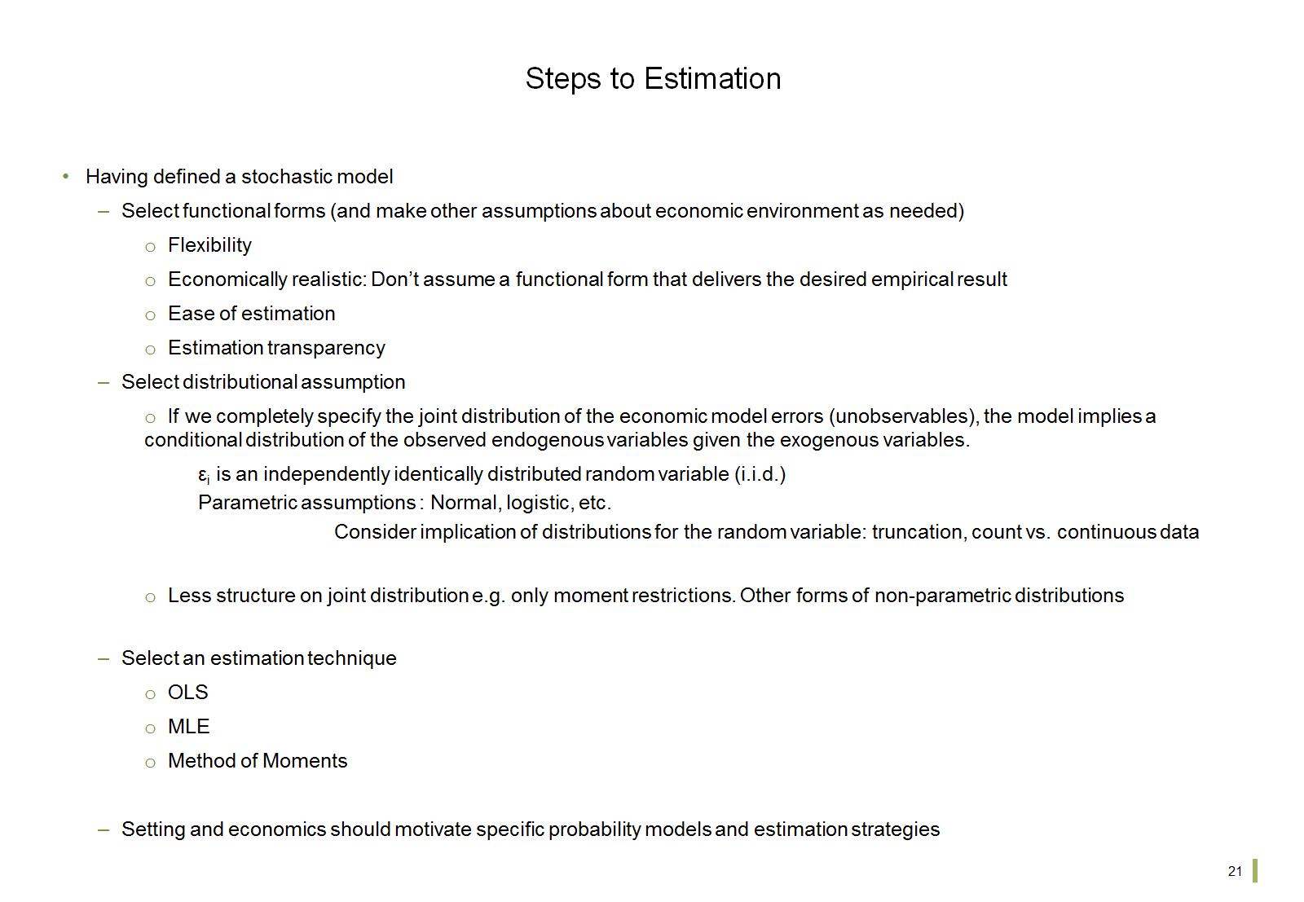
Steps to Estimation

Slide 23
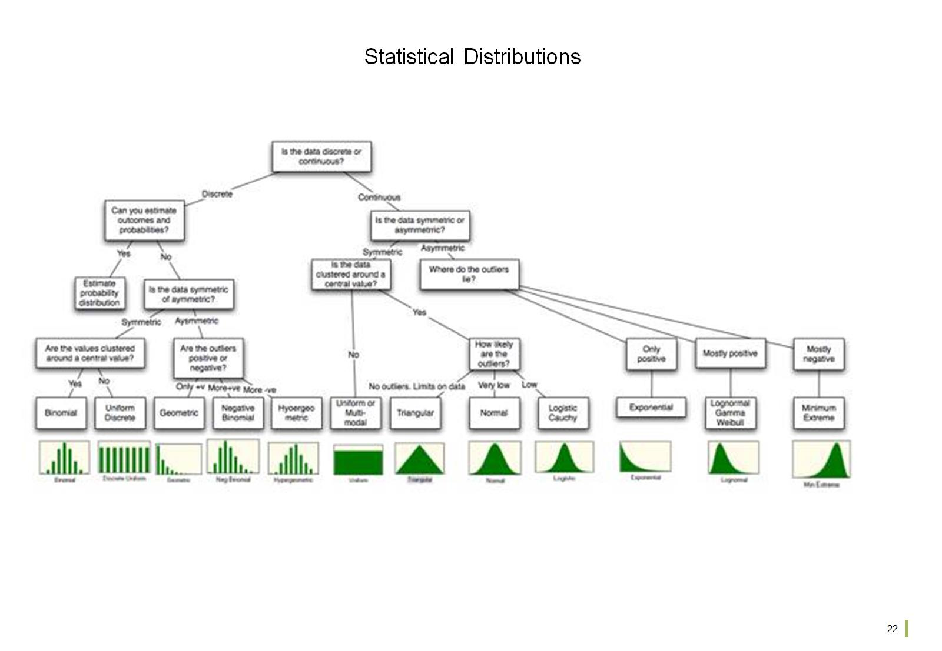
Statistical Distributions

Slide 24
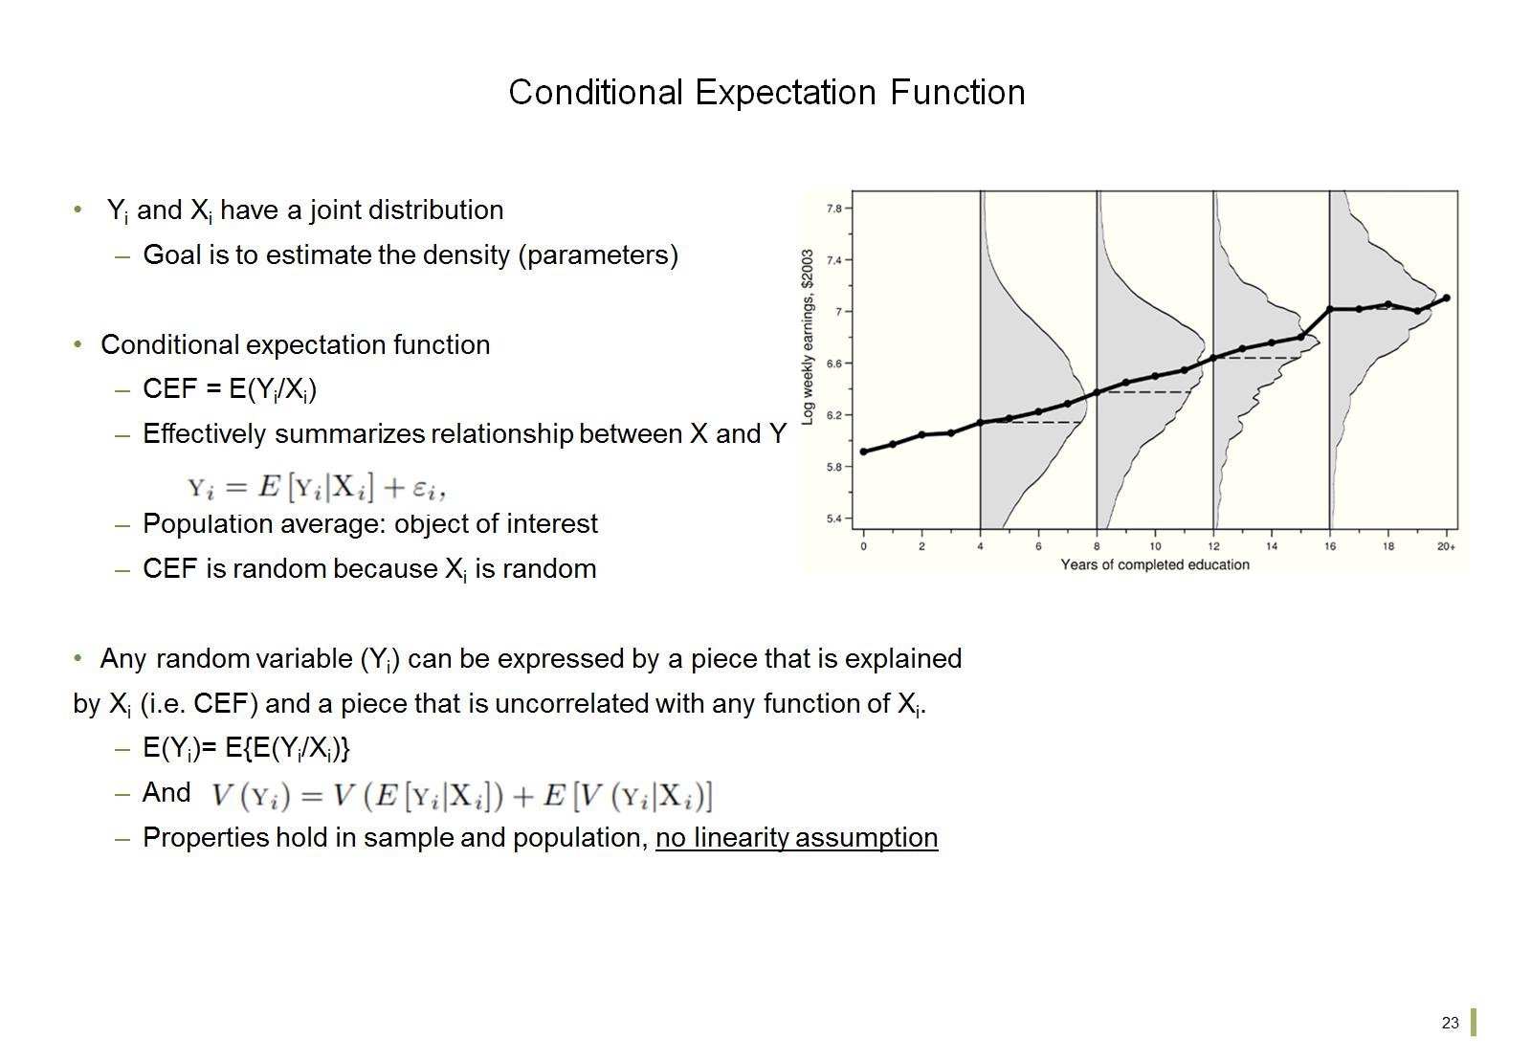
Conditional Expectation Function

Slide 25
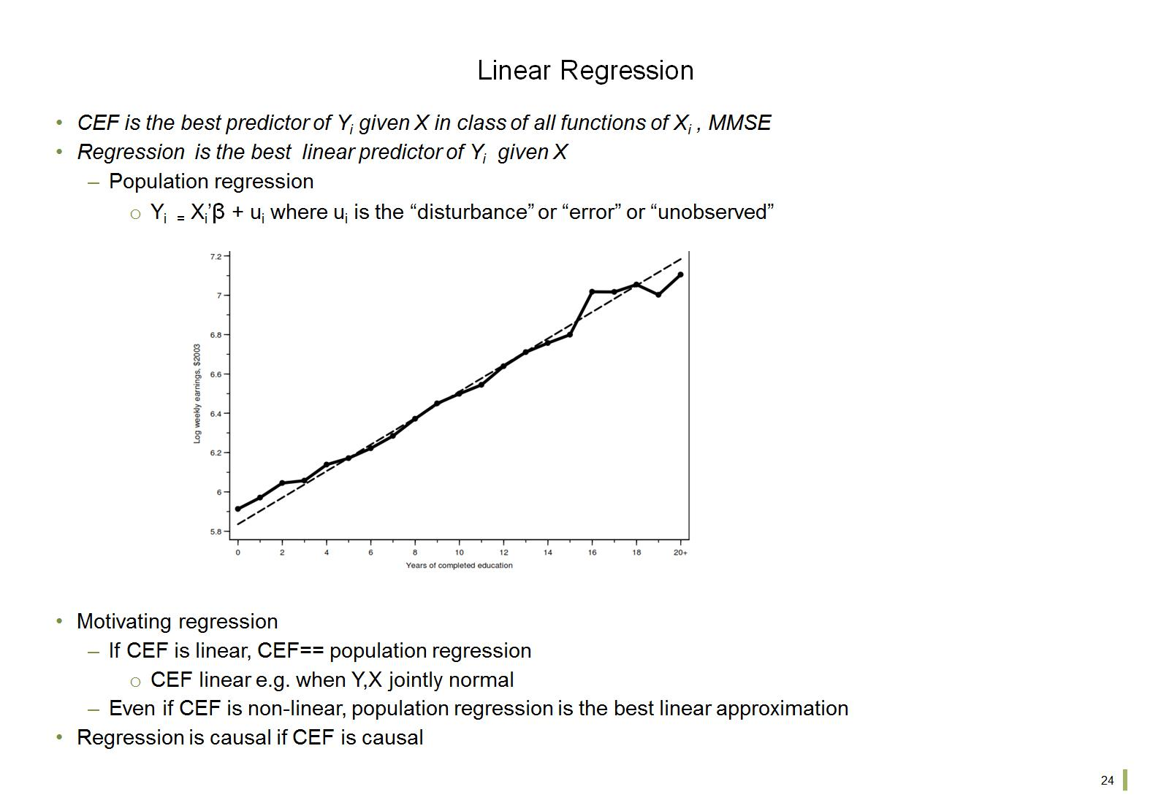
Linear Regression

Slide 26
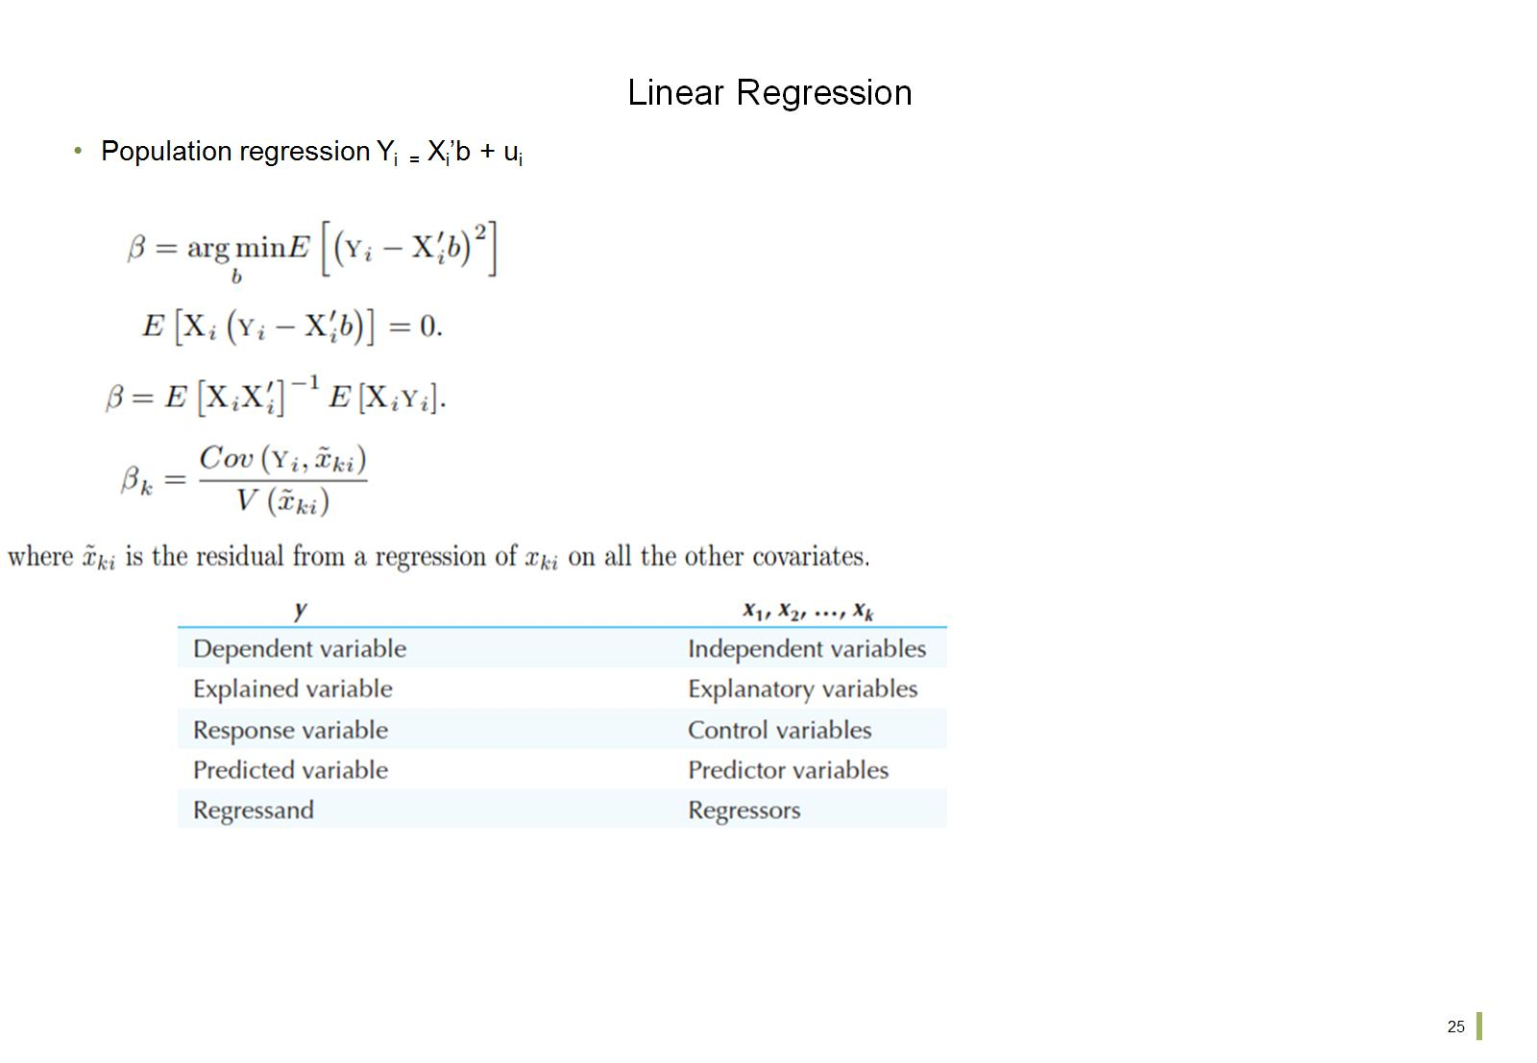
Linear Regression

Slide 27
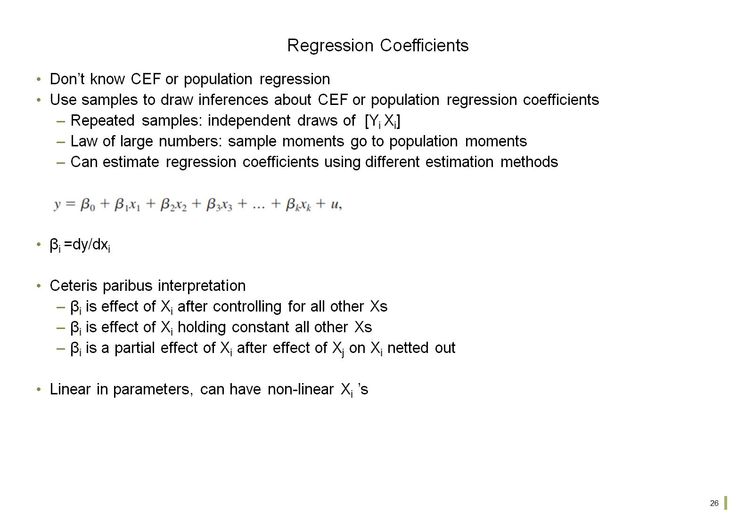
Regression Coefficients

Slide 28
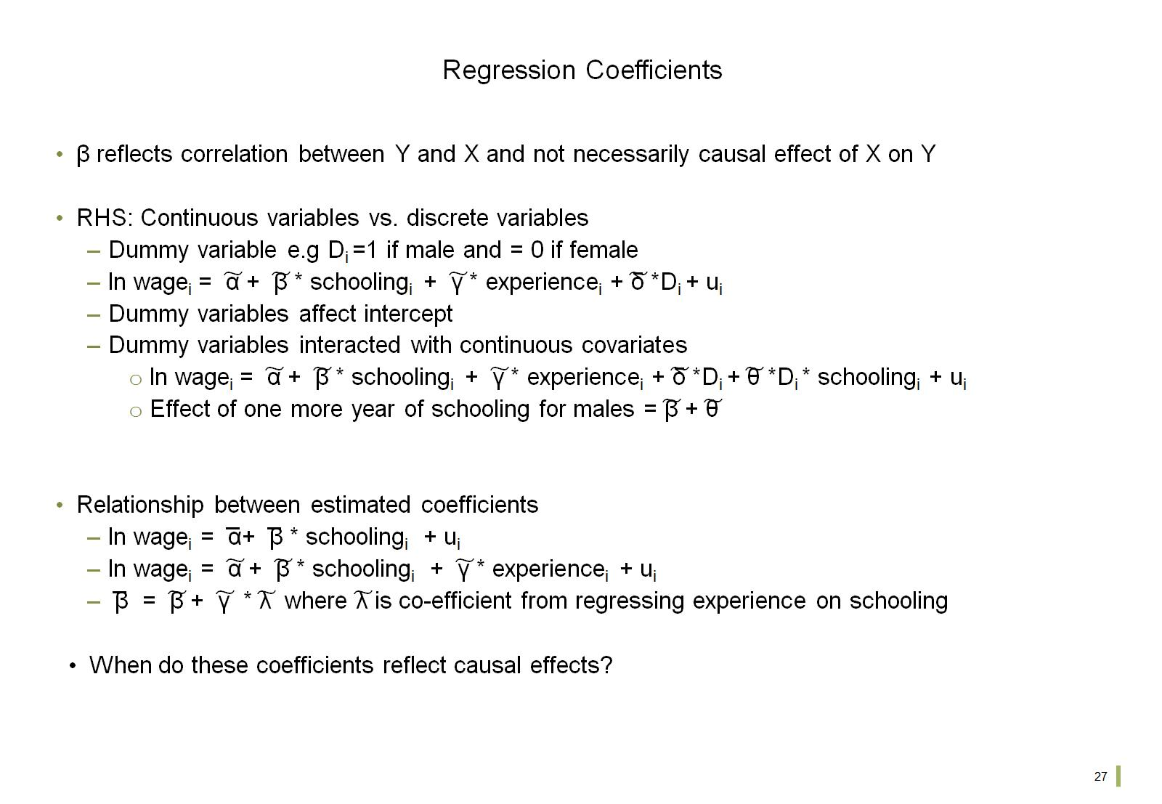
Regression Coefficients

Slide 29
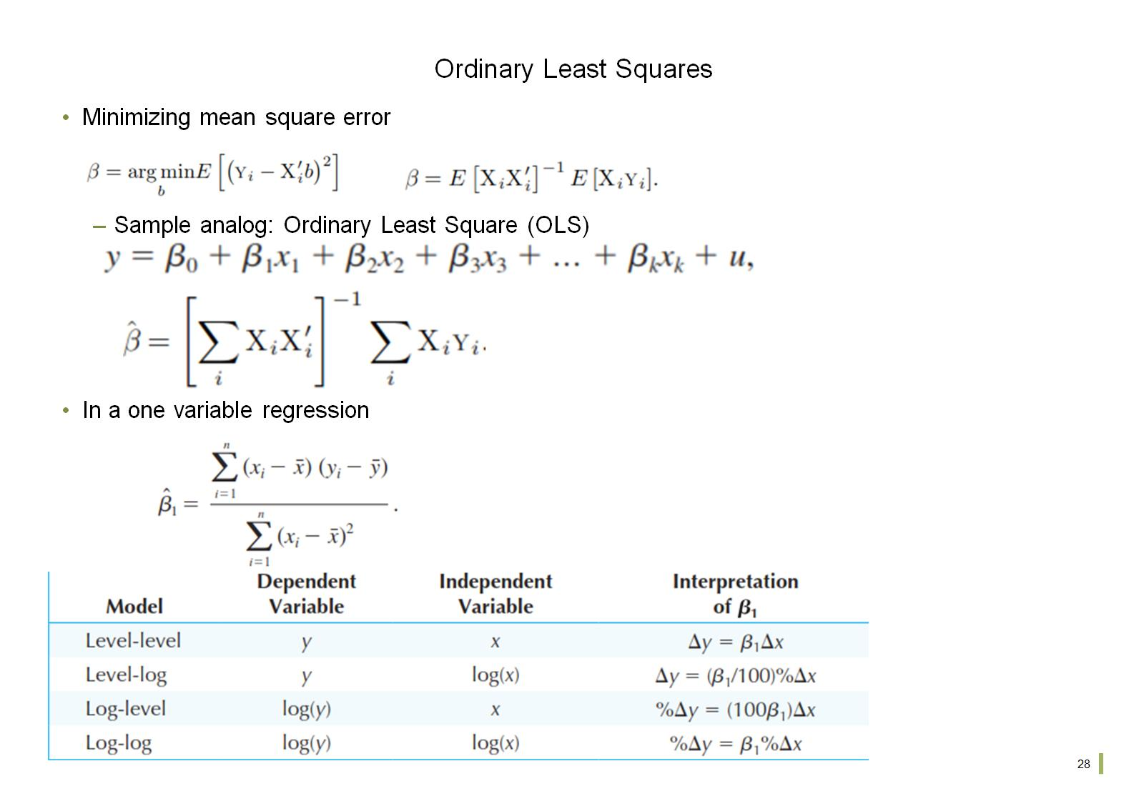
Ordinary Least Squares

Slide 30
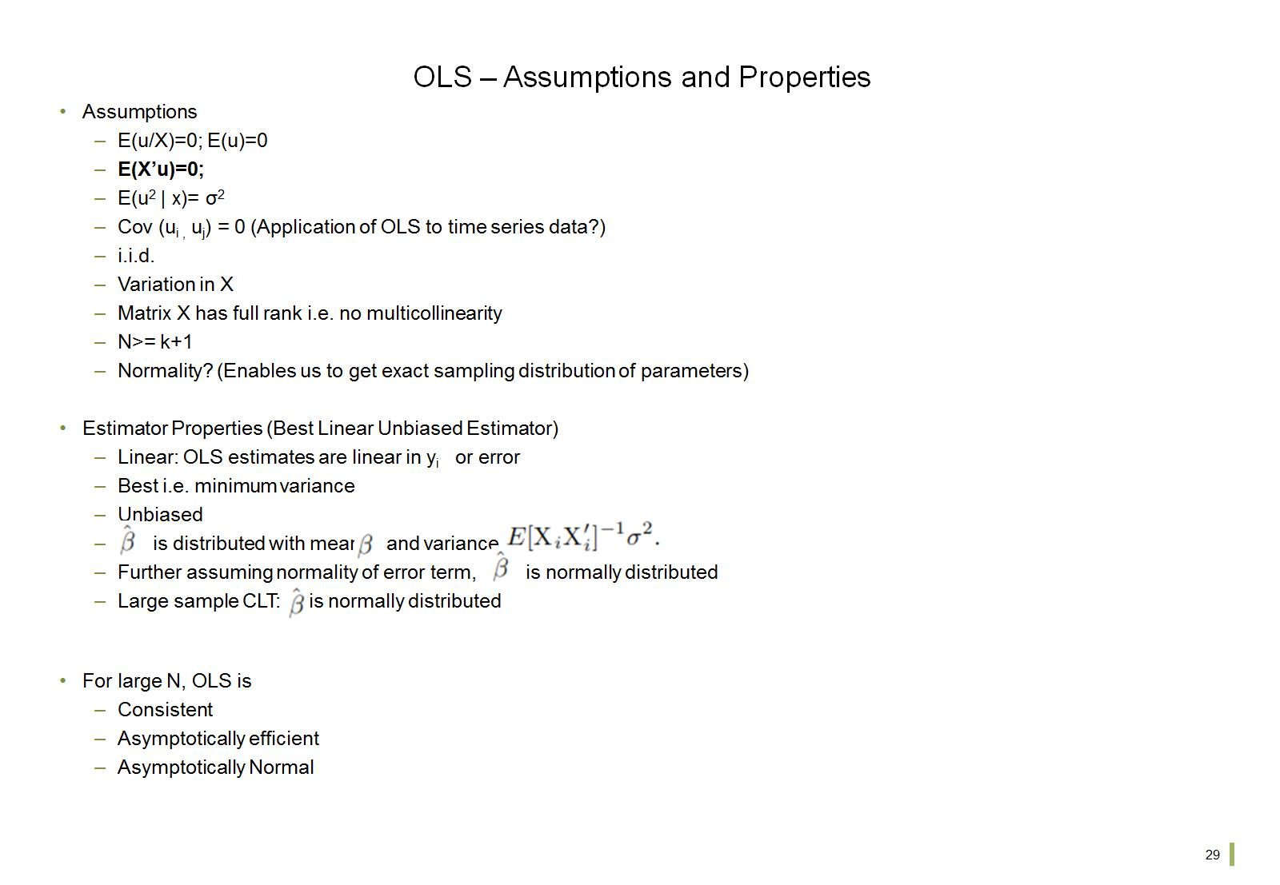
OLS – Assumptions and Properties

